Slide 1
Javascript Quality
Huang, Sammy

Slide 2
Agenda
Mocha
Assert
Javascript Mock in test
Javascript code coverage

Slide 3
Mocha Tutorial

Slide 4
WHAT IS MOCHA
Mocha is an open source unit testing framework for automatically unit testing Javascript programs.
Mocha provides functionality for writing and running unit test cases for a project under development, and is helpful when doing Test-Driven Development (TDD).
Web site: https://mochajs.org/

Slide 5
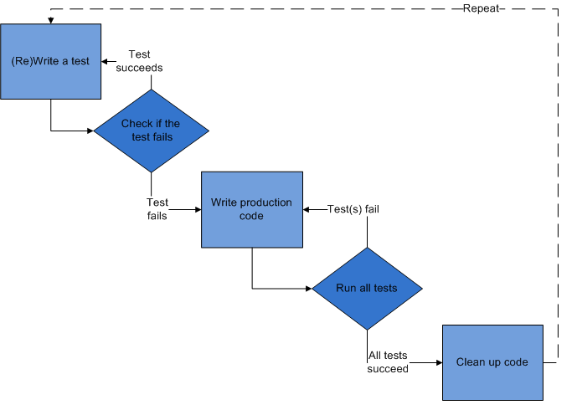
What is TDD
Test-driven development (TDD) is a software development process
First the developer writes a failing automated test case
And then produces code to pass that test
Finally refactors the new code to acceptable standards

Slide 6
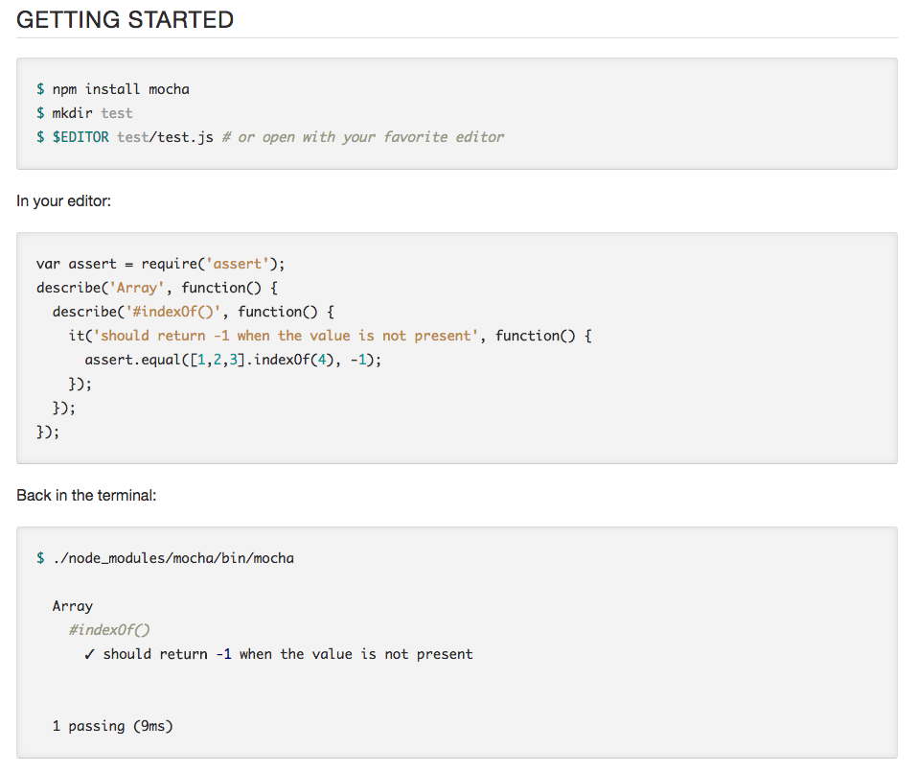

Slide 7
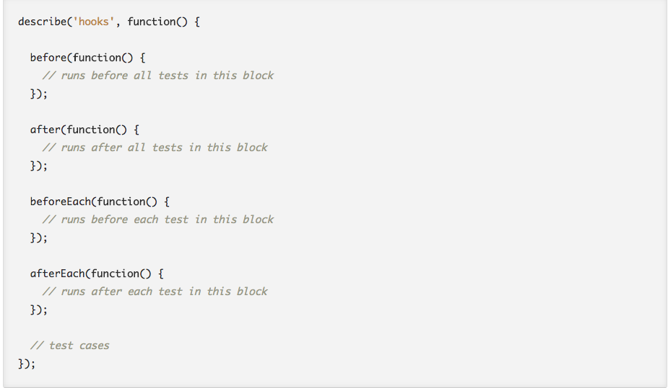
HOOKS

Slide 8
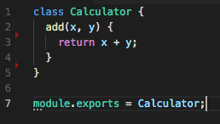
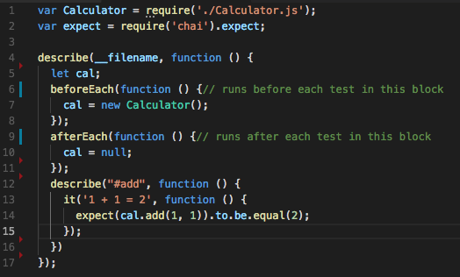
How to write a test case
Example
The class to be tested
Test case

Slide 9
CHAI Tutorial

Slide 10
WHAT IS CHAI
Chai is a BDD / TDD assertion library for node and the browser that can be delightfully paired with any javascript testing framework.
http://www.chaijs.com/

Slide 11
Assertion Styles
Assert
Expect
Should
var foo = 'bar’
assert.equal(foo, 'bar’)
expect(foo).to.equal('bar’);
foo.should.equal('bar');

Slide 12
API Reference
expect(2).to.equal(2); // Recommended
expect('foobar').to.include('foo’);
expect(true).to.be.true; // Recommended
expect([]).to.be.empty;
http://www.chaijs.com/api/bdd/

Slide 13

Design a better test case
Consider real world scenarios
Test with not only normal case but also boundary conditions

Slide 14
Best Practices
Don't assume the order in which tests within a test case run (which means one test should not relay on the other test case), use static suite method when needed
Avoid writing test cases with side effects and keep independent
Keep tests small and fast

Slide 15
SINON Tutorial

Slide 16
What is sinon
Sinon is a mocking framework that supports unit test against JavaScript code with mock objects
Sinon objects can simulate the behavior of complex, real objects

Slide 17
Java codecoverage

Slide 18
What is code coverage
Outlines how thoroughly your tests exercise your code base
Code coverage is an indirect measure of quality
Code coverage can be classified as white-box testing because code coverage helps to identify paths in your program that are not getting tested

Slide 19
Why is it useful
Coverage analysis assures the quality of your set of tests, not the quality of the actual product
Code coverage helps to identify paths in your program that are not getting tested
Useful when testing logic-intensive applications with a lot of decision points

